Slide 1
UNIT 6a:
PNG COASTAL FISHERIES

Slide 2
Coastal fisheries
Activity 6.1: Assess prior knowledge by class discussion of their understanding of coastal fisheries in their country

Slide 3
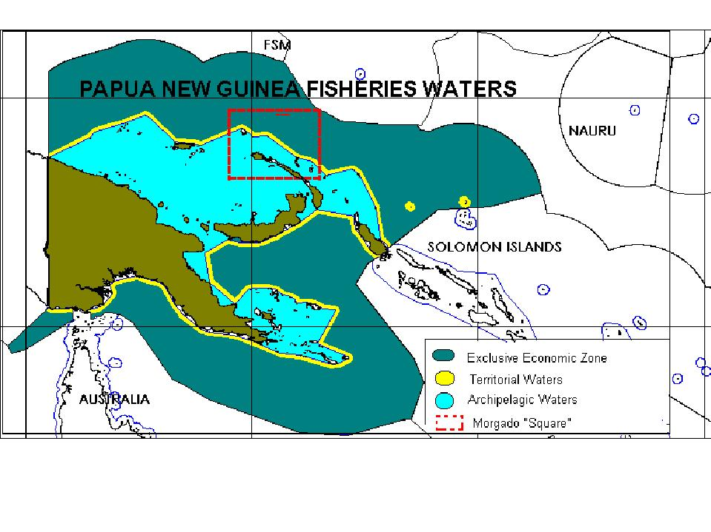

Slide 4
What are Coastal Fisheries?
Small scale and Traditional low cost fishing inside the 3-6 nautical mile limit from the shoreline or reef edge. Now extending to 6-12 Nautical miles.
Habitats fished include estuaries, lagoons, sand/mud flats, fringing and barrier reefs, nearshore oceanic.
PNG coastline ~ 21,250 km with 61 % of population within 100 km of the coast.
About 300 species taken in coastal fisheries. In 2007 total coastal fisheries catch was ~ 35,000 t; 80 % for subsistence.

Slide 5
PROVINCE | REEF AREA (hectares)- less than 30 m deep | POPULATION 2011 CENSUS | PERCENT COASTAL POPULATION | COASTAL POPULATION | COASTLINE (km)
MILNE BAY | 1,287,000 | 269,954 | 63.1 | 170,340 | 2,624
CENTRAL | 187,000 | 237,016 | 27.9 | 66,127 | 748
EAST SEPIK | 21,000 | 433,481 | 5.9 | 25,575 | 304
SANDAUN | 20,000 | 227,657 | 12.3 | 28,001 | 278
MANUS | 230,000 | 50,321 | 53.6 | 26,972 | 568
NEW IRELAND | 139,000 | 161,165 | 77.1 | 124,258 | 1,650
BOUGAINVILLE | 240,000 | 234,280 | 23.0 | 55,200 | 806
MOROBE | 77,000 | 646,876 | 6.7 | 43,340 | 752
ORO | 517,000 | 176,206 | 11.5 | 20,263 | 650
MADANG | 29,000 | 487,460 | 10.4 | 50,695 | 628
GULF | ? | 121,128 | 29.8 | 36,096 | 746
WESTERN | 104,200 | 180,455 | 14.4 | 25,985 | 1,058
NCD | - | 318,128 | 100 | 318,128 | -
WEST NEW BRITAIN | 137,000 | 242,676 | 43.2 | 104,836 | 1,640
EAST NEW BRITAIN | 68,000 | 271,252 | 27.1 | 73,509 | 774
TOTAL | 2,923,000 | 4,058,055 |  | 1,118,630 | 13,226 (21,250 REVISED TOTAL)

Slide 6
In PNG there are three main types of coastal fisheries:
Artisanal (small scale commercial fishing)
Subsistence (local consumption)
Industrial scale prawn fishing

Slide 7
Subsistence Fishery
A fishery in which the catches are shared and consumed directly by the families of the fishers and community members rather than being bought by sellers in the next larger market.
Traditional canoes are the main vessels but increasingly more fibreglass dinghy’s with outboards.
Traditional methods are used but also modern gears such as nylon nets.
In excess of 500 species are harvested – anything edible.
As species begin to be locally overharvested communities shift to other species

Slide 8
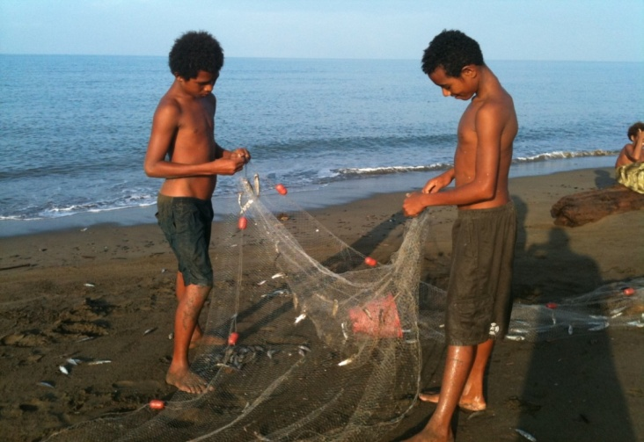
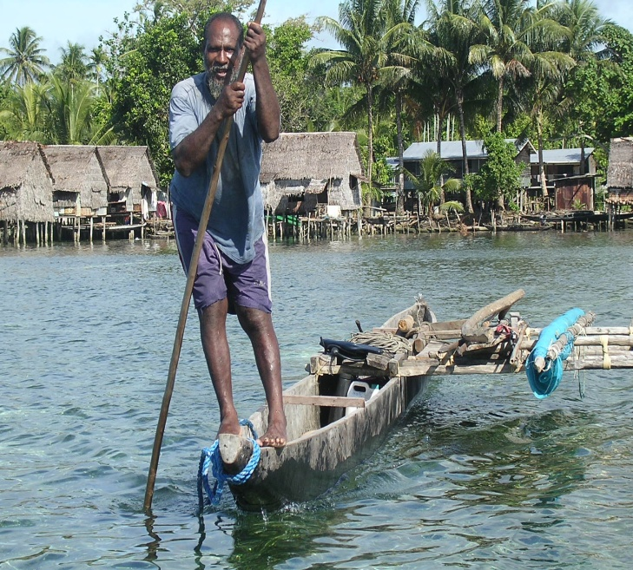
Subsistence Fishery typical characteristics
based on traditional, customary and cultural norms
Women use different methods to men
Women and young tend to do reef gleaning for sedentary species, eg. clams and other shells
mostly traditional canoes used
traditional management in some areas
some methods require communal efforts
catch is shared among family and local community
catch is often exchanged for garden foods

Slide 9
Example: Characteristics of subsistence reef fishery at Pororan Island, Buka
NUMBER OF FISHERMEN | About 1,000
WHO | Children, women, men
FISHING METHODS | Handline, traditional nets, gill nets, spear fishing, etc
VESSELS | Mainly canoes
TARGET SPECIES | Reef fish, shells, other marine organisms
WHEN | When needed; sometimes everyday
WHERE | Reef flat, reef edge, lagoon,
CATCH UTILISATION | Consumption & Barter

Slide 10
Artisanal Fishery
A small-scale, traditional and low cost fishery in which relatively small vessels (usually fibreglass dinghies) take catches, often consisting of a great variety of different species, that are primarily sold and consumed locally.
Multiple methods are used: reef gleaning, hand lining, drop lining, spearfishing, hand collecting, gill nets and surround nets.
Catch is sold mostly to local and urban markets and to local shops and restaurants

Slide 11
Example: Characteristics of Madang FAD Artisanal fishery
NUMBER BOATS & FSHERMEN | 40 boats, 120 fishermen
WHO | Adult males
FISHING METHODS | Trolling, Drop line
VESSELS | 23 foot Dinghys, 40HP
TARGET SPECIES | Tuna, Sailfish, rainbow runner,
WHEN | Seven days a week
WHERE | Around FADS (3-4 FADS)
VOLUME OF CATCH | About 3-6 tonnes per day (fishery)

Slide 12
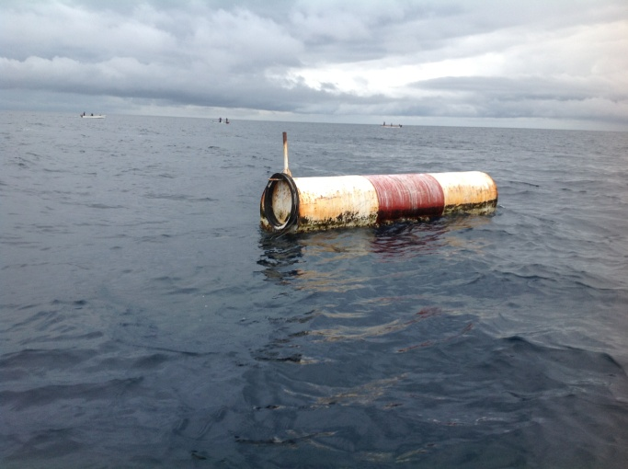
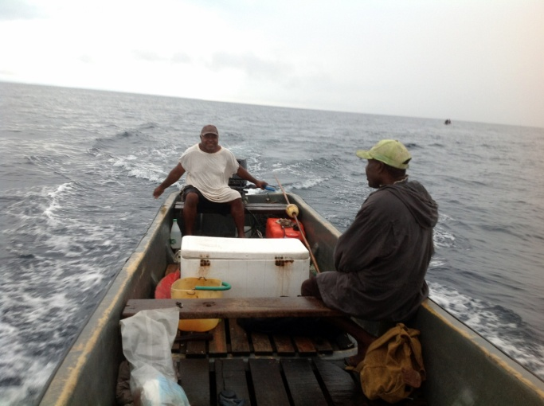
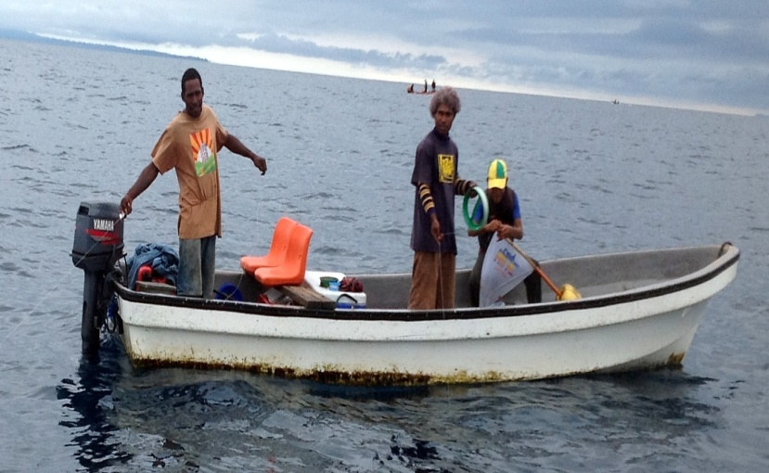
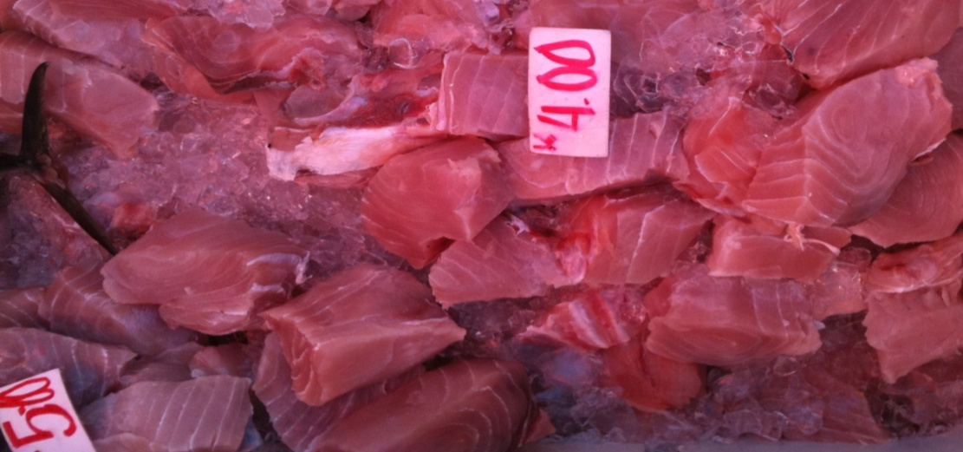
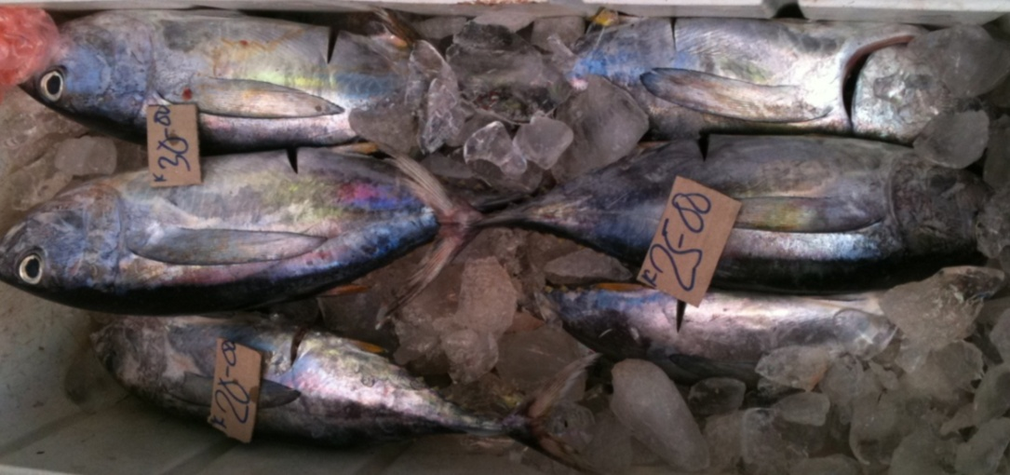

Slide 13
Export based artisanal fisheries
Typically species targeted are:
  High value
  Easy to harvest
  Minimal capital investment
  Simple preservation methods
Unfortunately these characteristics often result in overfishing
Main species are:
  Beche-de-mer
  Lobster
  Trochus
  crabs

Slide 14
Beche de mer fishery
Despite a management plan was heavily overfished and is currently closed.
More than 21 species were targeted; high value ones such as sandfish and prickly redfish preferred
Collected by reef walking or freediving depending on species/habitats
Collected animal is boiled and sun or smoke dryed then sold to buyers/exporters
Between 2000 – 2009 5.5 million t was exported (~ 296 million kina)
Peaked in 2007 with 795 t caught with a value of 52 million kina

Slide 15
BECHE-DE-MER VOLUME

Slide 16
BECHE-DE-MER VALUE

Slide 17
BECHE-DE-MER EXPORT BY PROVINCE -2000-2009

Slide 18
Trochus fishery
Hand collected by snorkelling
Product is dried then sold to traders, processors and exporters
Graded as small, medium or large
Shells are used to make buttons and ornaments
Powdered scraps used in lacquers and shampoos
No management plan but there are size limits (min and max)
Total shell export quantity has increased from 1996-2004, while export of buttons has been relatively stable

Slide 19
TROCHUS BUTTONS

Slide 20
TROCHUS SHELLS

Slide 21
LOBSTER EXPORTS

Slide 22
CRAB EXPORTS- 1996-2004

Slide 23
Industrial scale prawn fishery
A trawl fishery that targets 3 key species: banana, black tiger and endeavour prawns
Three fisheries: Gulf of Papua (main one), Torres Strait Protected Zone, and Orangerie Bay
Management plans limit the number of vessels; companies in the fishery must also be owned by PNG citizens
The Gulf of Papua fishery catches between 400 and 1300 t annually with ~ 90 % exported
The Orangerie Bay fishery has one boat but the fishery is currently closed due to conflict with local communities

Slide 24
Activity 6.2 – Select one of the export based Artisanal Fisheries identified above (Beche-de-mer, Lobster or Trochus), or another fishery you are familiar with, and describe its key characteristics.
This should include aspects such as: species targeted, their life history & biology, where are they caught, who catches them, what methods/gears are used, catch volumes and trends, management, how many vessels, how much is exported, etc.

Slide 25
Reflection
Reflection: unit review, students to review main concepts of unit in the course notes, contribute any new words (new to them) to their own personal glossary in the back of their notebook (local language equivalent terms should also be recorded where possible)

